Slide 1
The Network Layer Routing in the Internet
School of Software Engineering
South China University of Technology
Dr. Chunhua Chen
chunhuachen@scut.edu.cn
2020 Spring

Slide 2
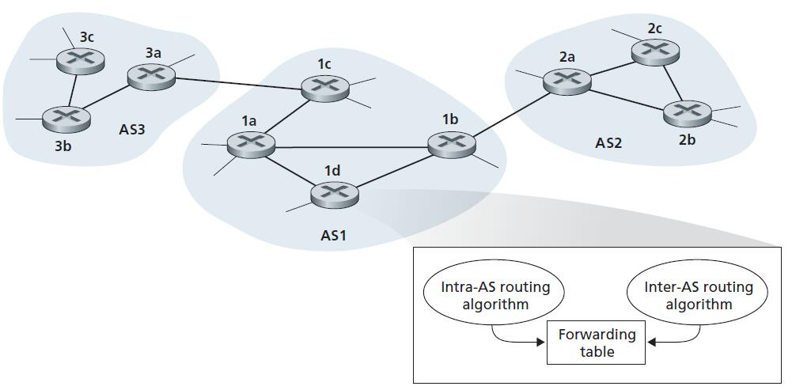
Hierarchical Routing
Scale
hundreds of millions of routers
Administrative autonomy: AS

Slide 3


Intra-AS Routing in the Internet
An intra-AS routing protocol is used to determine how routing is performed within an autonomous system (AS).
In the Internet (extensively used)
Routing Information Protocol (RIP)
distance-vector based
Open Shortest Path First (OSPF)
link-state based

Slide 4
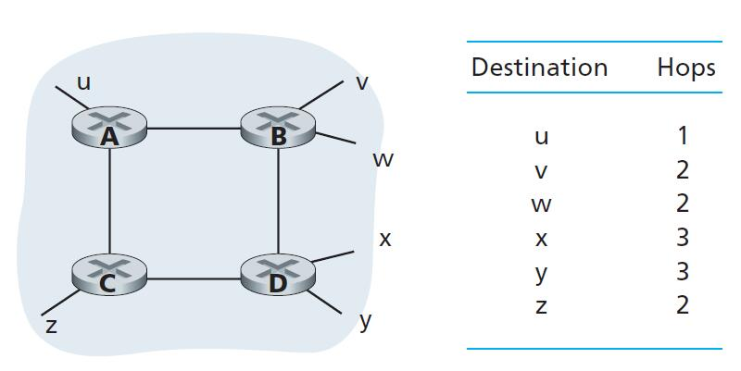
Routing Information Protocol (RIP)
Cost metric: each link has a cost of 1.
Cost of a path:
from source router to a destination subnet;
hop, which is the number of subnets traversed along the shortest path from source router to destination subnet, including the destination subnet.
The maximum cost of a path is limited to 15, thus limiting the use of RIP to autonomous systems that are fewer than 15 hops in diameter.

Slide 5
Routing Information Protocol (RIP)
RIP advertisements/RIP response message
Neighboring routers exchange distance vectors with each other
Approximately every 30 seconds
the sender’s distance to each of a list of up to 25 destination subnets

Slide 6
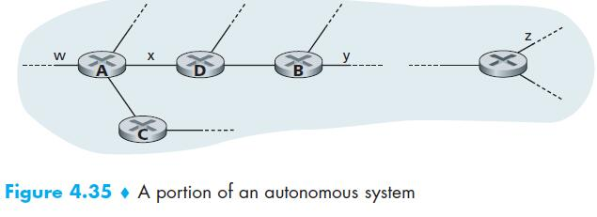
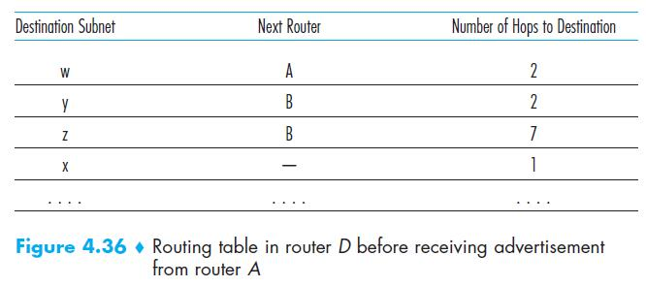
Routing Information Protocol (RIP)

Slide 7

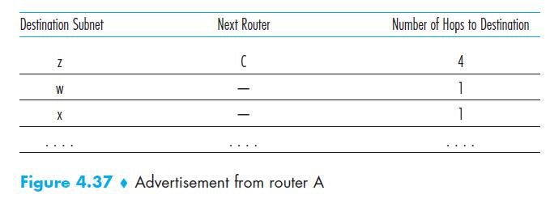
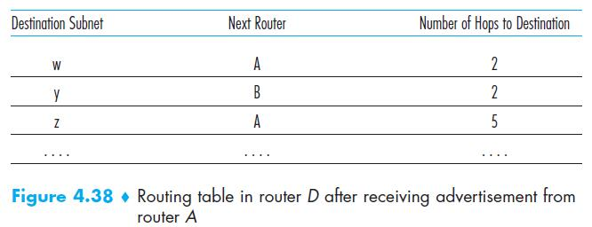
Routing Information Protocol (RIP)
C (D, A)= 1

Slide 8
Open Shortest Path First (OSPF)
Individual link costs are configured by the network administrator
set all link costs to 1, or
set the link weights to be inversely proportional to link capacity in order to discourage traffic from using low-bandwidth links.
By flooding of link-state information, a router constructs a complete topological map (that is, a graph) of the entire autonomous system.
a change in a link’s state, or every 30 minutes
The router then locally runs Dijkstra’s shortest-path algorithm to determine a shortest-path tree to all subnets, with itself as the root node.

Slide 9
Inter-AS Routing: BGP
The Border Gateway Protocol version 4 is the de facto standard inter-AS routing protocol in today’s Internet. It is commonly referred to as BGP4 or simply as BGP.
Obtain subnet reachability information from neighboring ASs.
Propagate the reachability information to all routers internal to the AS.
Determine “good” routes to subnets based on the reachability information and on AS policy.
BGP is extremely complex, not cored here, but you are required to read the chapter in the text book
AS-PATH, NEXT-HOP, Routing Policy

